Slide 1
Antibody Germline Evolution within the Context of Pre-Vaccination Antigen Exposure Requirements Specification
Edward T. Moseley
August 3rd 2023
DS 288: Capstone Project

Slide 2
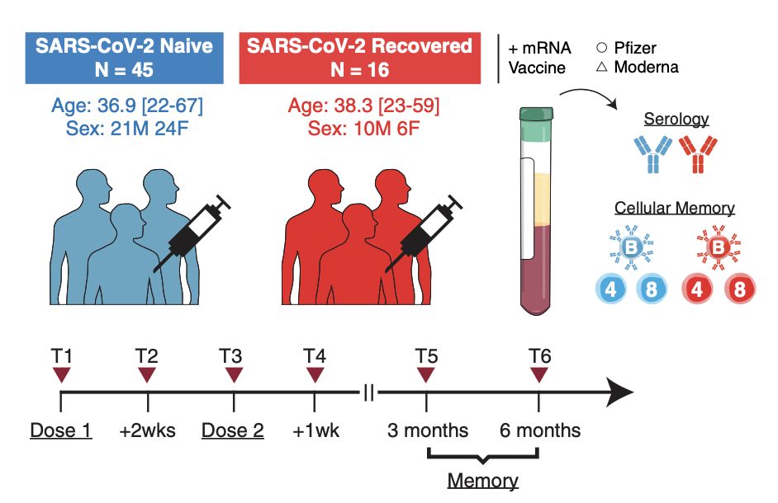
High-Level Requirements and Data Sources
Goal: To compare the post-immunization germline evolution of two groups– those who were pre-exposed to the antigenic material through wild-type infection, and those who were naïve to it.
Question: How does prior infection modulate antibody germline evolution in the context of vaccination?
Adaptive Immune Receptor Repertoire (AIRR-seq) Analysis Framework:
Immcantation – library for cleaning, aligning, structurally annotating, and assessing the clonal diversity of AIRR-seq data.
AIRR-seq Data Source:
iReceptor Database
45 Naïve Participants, and 16 Participants who recovered from the virus.
9,104,391 associated germline sequences
Goel, et al. mRNA vaccines induce durable immune memory to SARS-CoV-2 and variants of concern. Science (2021)
Timepoints of interest
Goel, et al. (2021)

Slide 3
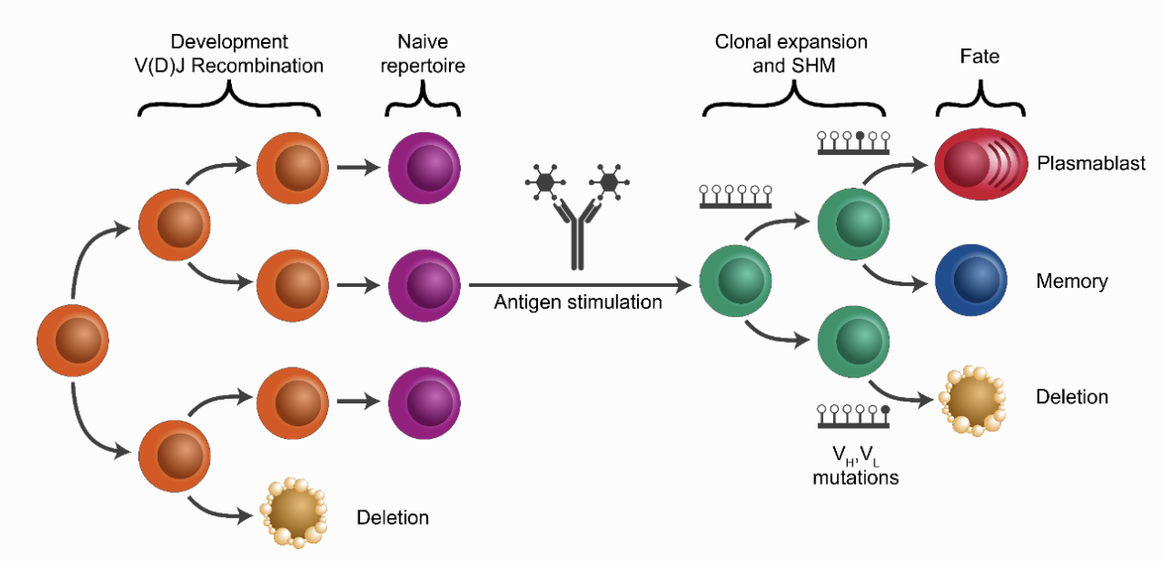
Questions, Target Audience, Users
Specific Questions:
Does pre-exposure to wild-type antigenic material act to diversify the antibody repertoire?
Is there a difference in the:
Complementary Determining Regions (CDRs)?
Rates of Somatic Hypermutation (SHM)?
Lineage (Breadth vs. Depth of evolution)?
(Wishlist) Is the germline data predictive of whether an individual had a prior infection?
Image from Immcantation documentation, demonstrates antigen stimulation and diversity of clonal lineage.
Target Audience/Users:
Biochemists, Computational Biologists, Physicians, Immunologists, Virologists and Vaccinologists

Slide 4


Inputs/Outputs
Set of Experiments
Clonal Abundance/Diversity
Gene Usage
Rates of Somatic Hypermutation
Lineage Analysis
CDR3 Properties
iReceptor Database
Goel, et al. Data
Immcantation Suite
Goel, et al. (2021) Cohort
AIRR-Seq Data
Germline Analysis
Statistical Comparison
Naïve (n = 45) vs.
Pre-Exposed (15)
Cohort Metadata
Possible to model the probability of pre-vaccine exposure?
Results Tables
and Graphs
(Wish-list)
Demographics Table (Age, etc.)
References:
Goel, et al. mRNA vaccines induce durable immune memory to SARS-CoV-2 and variants of concern. Science (2021)
Cizmeci, et al. Distinct clonal evolution of B-cells in HIV controllers with neutralizing antibody breadth. eLife (2021)
Corrie et al. iReceptor: a platform for querying and analyzing antibody/B-cell and T-cell receptor repertoire data across federated repositories, Immunological Reviews (2018)
Vander Heiden, Yaari, et al. pRESTO: a toolkit for processing high-throughput sequencing raw reads of lymphocyte receptor repertoires. Bioinformatics (2014)
Gupta, Vander Heiden, et al. Change-O: a toolkit for analyzing large-scale B cell immunoglobulin repertoire sequencing data. Bioinformatics (2015)

